Slide 1


W.K. Kellogg Foundation:
Giving In Communities of Color
Fostering An Equitable and Responsive Philanthropic Sector
Notes:
Good afternoon-
I am excited to provide an update of our philanthropic engagement work that embodies our community philanthropy and effective nonprofit objectives all in an effort to foster an more effective and responsive nonprofit and philanthropic sector.

Slide 2
The VISION
Recognize – Celebrate
-Promote
Shift the Paradigm of Givers and Takers
Emerging Giving Models
& Traditions
Accelerate Philanthropy
+
Communities of Color
Sustain Community
Responsiveness
Leverage Opportunities
Mainstream
+
Social Change Engagement

Slide 3
The GOALS
1
2
3
4
1
3
4
ENGAGE
new and existing donors
CONNECT
the work and the knowledge of both organizations and leaders by catalyzing a field-wide community of practice
ADVANCE
the practice of identity based philanthropy by strengthening and building the capacity of community-led organizations and their leaders
PROMOTE
and celebrate the innovative work being done by identity based funds
1
2
3
4
ENGAGE new and existing donors
Build the capacity of identity based fund
Strengthen access to knowledge and tools and funding streams across mainstream philanthropy
Improve and build pipeline of leaders of color
Catalyze newer and stronger networks
Raise the visibility of identity based funds
Encourage and support research on giving across communities of color
Notes:
Goals:
Build the capacity of identity based fund
Strengthen access to knowledge and tools and funding streams across mainstream philanthropy
Improve and build pipeline of leaders of color
Catalyze newer and stronger networks
Raise the visibility of identity based funds
Encourage and support research on giving across communities of color

Slide 4
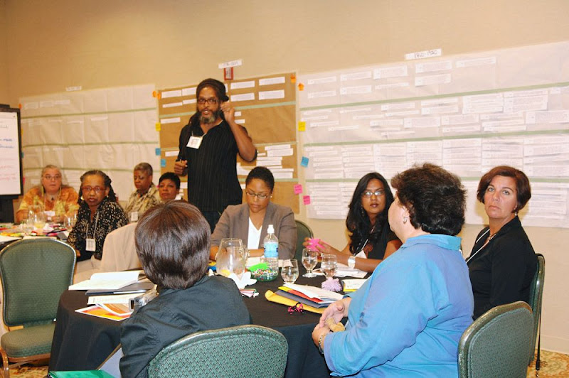
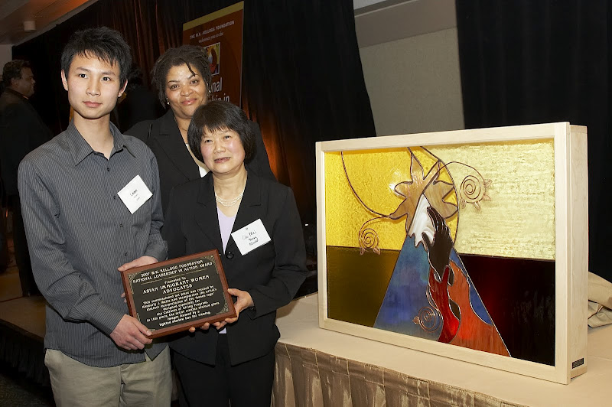
The ACTION
Capacity Building Support
Networking Conferences
Research, Reports and Briefings
National Leaders Award
Regional Collaboration Mini-Grants
Matching Gift and Donor Challenge Support

Slide 5
The RESULTS
What Happened
205
Working Collaborations
150
205 working collaborations across the network, sharing their strategies and knowledge
Community Engagement
150 outreach events attended by 2,500 + donors of color

Slide 6
The IMPACT
$$
Philanthropic Resources
$8.8 M
$5.7 M
$3 M
$8.8 million raised across the network
$5.7 million raised through two unique challenge grant programs from over 3,500 unique donors
Over $3 million re-granted in programs across communities of color
Notes:
Discuss current activities
Convened a design team for reacquaint group with WKKF, orient them in our new Fellowship approach and begin fellowship formation
Rationale for using a Design Team of leaders in the field/former WKKF fellows
Design Team is:
Thought leaders in areas of community development and civic engagement
Donating their time, dedicated to this work
Leading fellowship programs, multi-sectoral
All former WKKF fellows, feel like they want to give back
Progress by quarter
Convene design team, reacquaint them with WKKF values etc.
Develop curriculum and recruitment process
Refine process of recruitment and begin recruitment
Finalize first class of fellows and Announce fellowship at CCE convening in Nov.

Slide 7
Next STEPS
National Funders Collaborative focused on strengthening giving models, frameworks and innovations in communities of color
Interviews with funders during spring and summer
Fall funders meeting/briefing

